Slide 1
Docker compose : simple Flask app in app.py

Slide 2

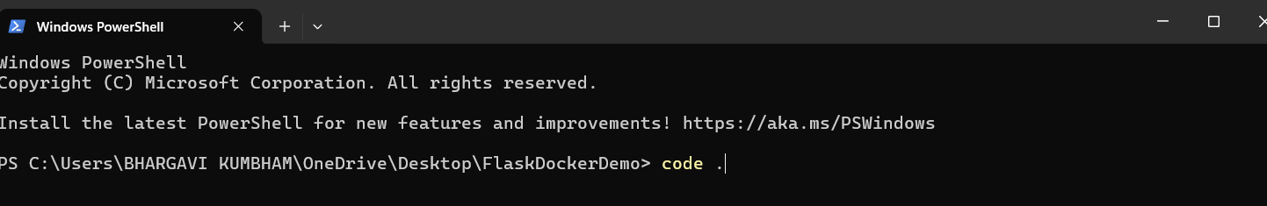
Create a new project folder FlaskDockerDemo
open folder and go to terminal

Slide 3
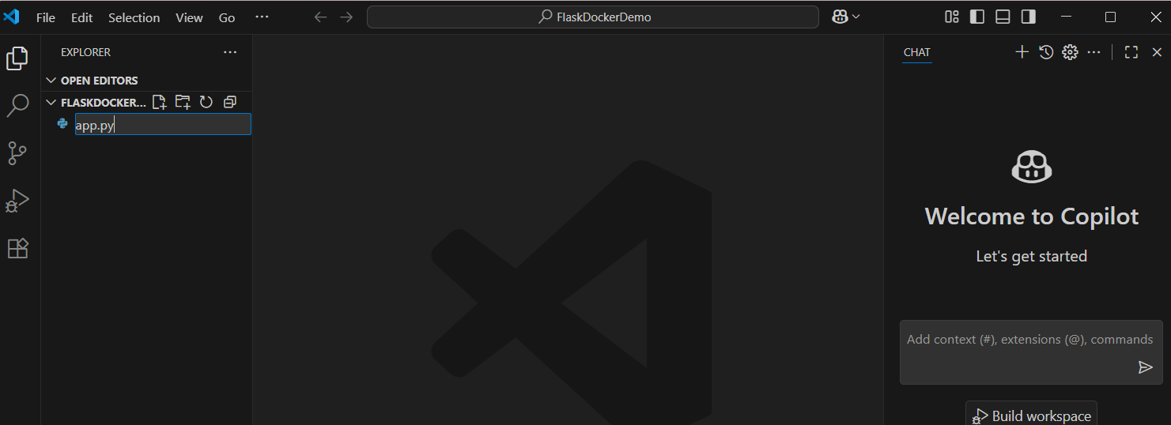

Slide 4
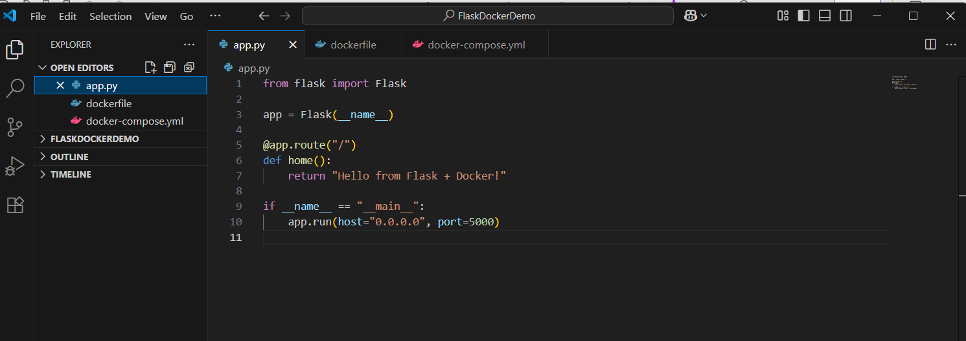
Task : Try this Create a simple Flask app in app.py:
from flask import Flask
app = Flask(__name__)
@app.route("/")
def home():
return "Hello from Flask + Docker!"
if __name__ == "__main__":
app.run(host="0.0.0.0", port=5000)

Slide 5
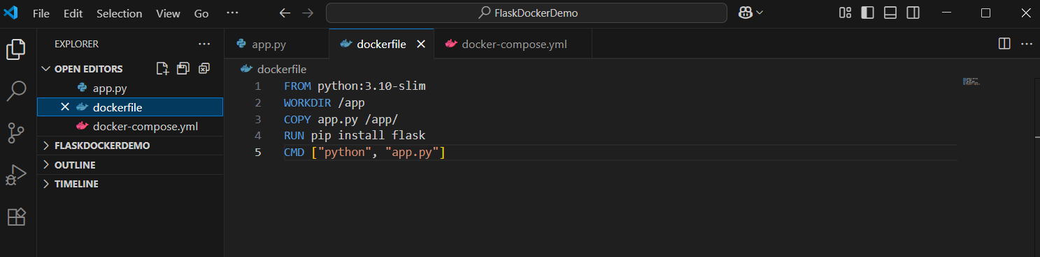
Add a Dockerfile in the same folder:
FROM python:3.10-slim
WORKDIR /app
COPY app.py /app/
RUN pip install flask
CMD ["python", "app.py"]

Slide 6
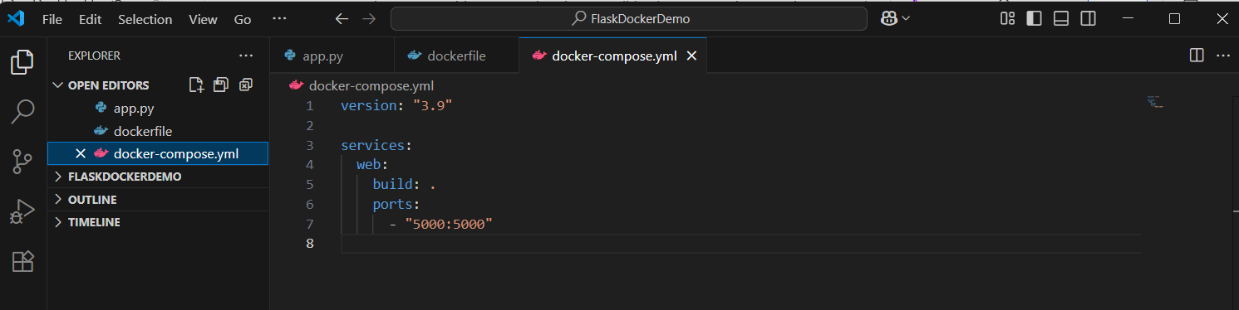
Update docker-compose.yml:
web:
build: .
ports:
- "5000:5000"
depends_on:
- db

Slide 7
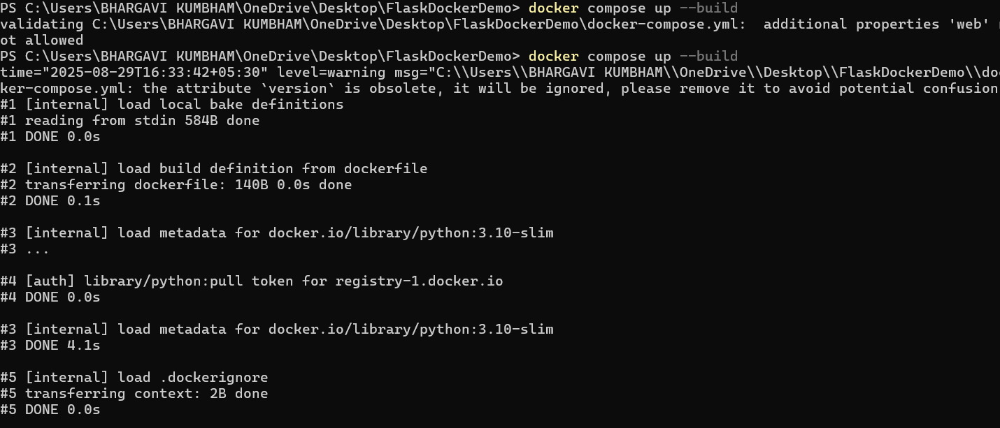
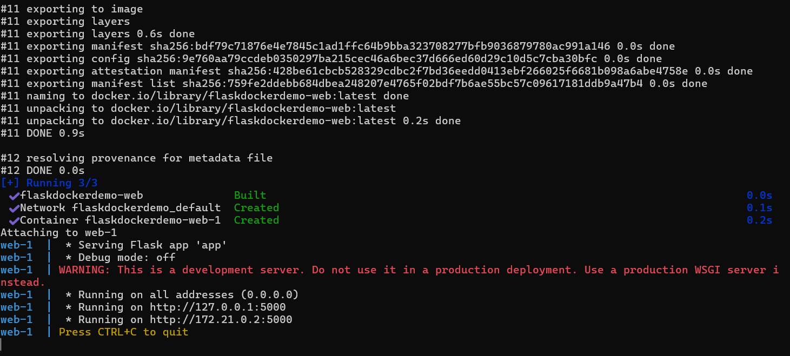
docker-compose up --build
press v ----> opens the docker hub

Slide 8
Visit http://localhost:5000

Slide 9
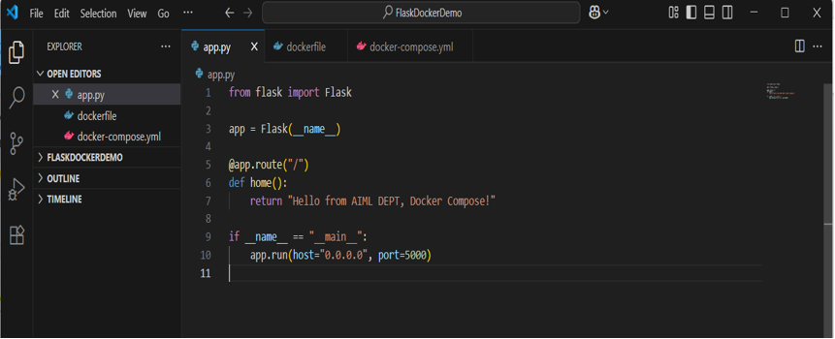
Change the return text in app.py (e.g., "Hello from AIML DEPT,Docker Compose!").
Rebuild:
docker compose up --build
Expected Output:
New message appears instantly after rebuild.

Slide 10

Change the text in app.py (e.g., "Hello from AIML DEPT,Docker Compose!"). Rebuild: docker compose up --build

Slide 11
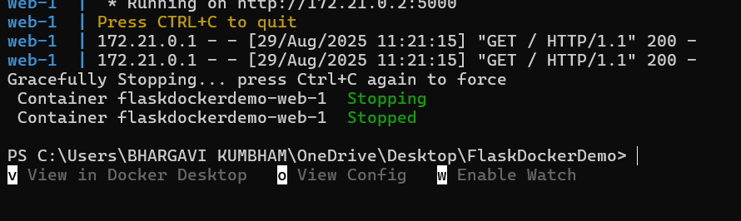
press Ctrl + c to come out of this

Slide 12
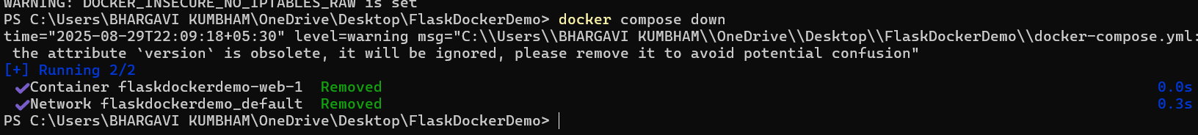
Remove containers docker-compose down

